Slide 1
Big Mountain Ski Resort Ticket Pricing Model

Slide 2
Purpose
Determine an accurate pricing strategy for
Build a predicative model for ticket price factor
Provide insight on the facilities that matter most

Slide 3
Key Findings
Scenario 1: Closure of runs up to 10 runs will result in a decrease in revenue
Scenario 2: Increase vertical drop by 150ft and additional chair lift
Ticket price increase by $1.99 and additional revenue of $3.5 million
Scenario 3: Scenario 2 + add 2 acres of snow making
Ticket price increase by $1.99 and additional revenue of $3.5 million
Scenario 4: Increase the longest run by 0.2 miles and add snow making of 4 acres
No change in ticket price
Recommendation: Scenario 2

Slide 4
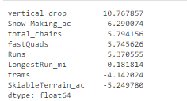
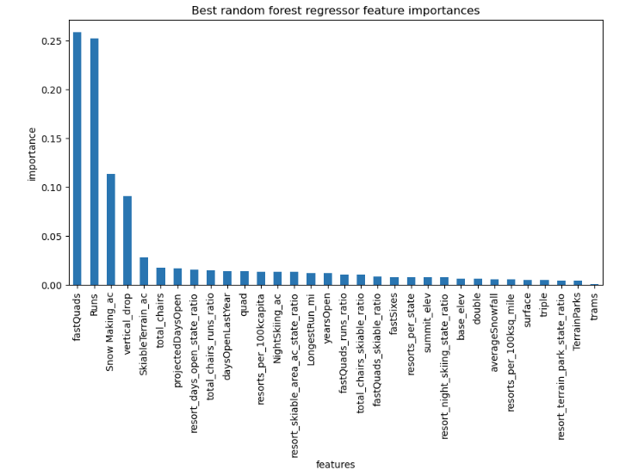
Model comparison Linear regression vs Random Forest Regression Model
Linear Regression
Random Forest Regression

Slide 5
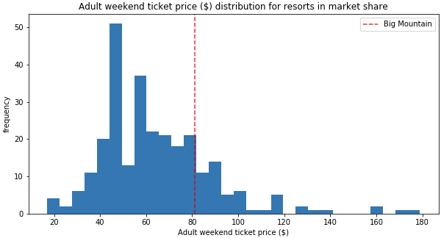
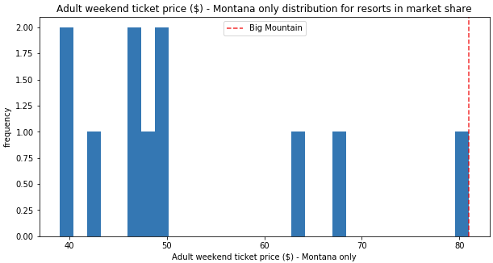
Big Mountain Resort Ticket prices
Ticket price distribution across resorts
Ticket price across the state of Montana

Slide 6
Modelled Data
Modelled price is $95.86 vs. actual price $81.00
MAE = $10.36 suggests there is room for an increase

Slide 7
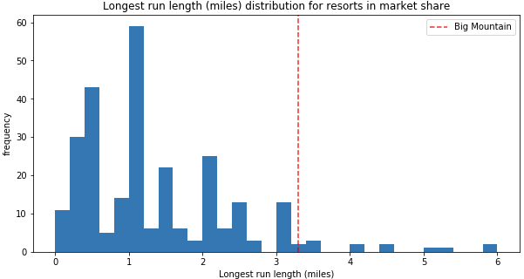
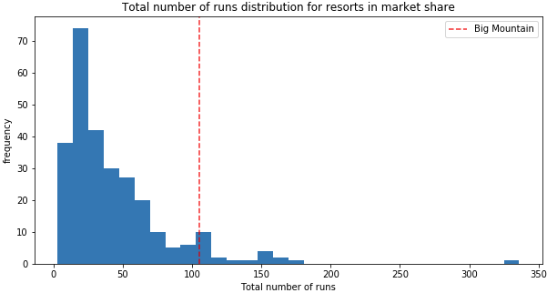
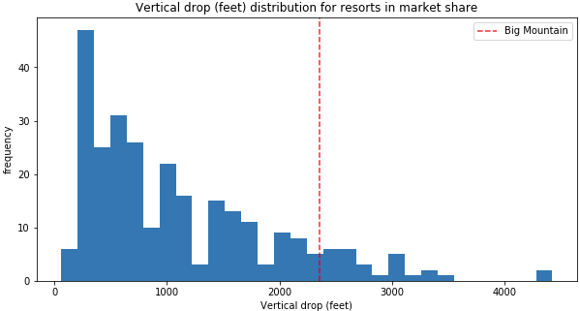
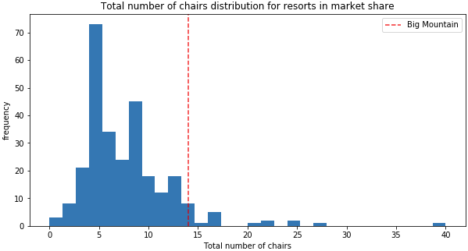
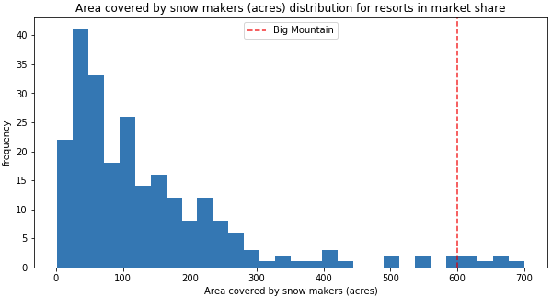
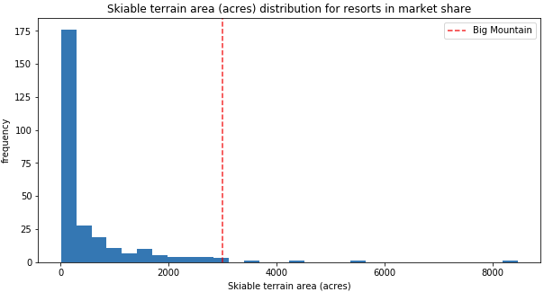
Big Mountain Feature comparisons

Slide 8
Summary & Conclusion
Big Mountain notable features:
Skiable terrain
Number of Runs
Snow making capacity
Number of Chairs
Model supports a price increase to $95.86 compared to the current price of $81
An increase in vertical drop with or without snowmaking will increase revenues by ~$3.5mil.

